Slide 1



UNIT 2
Lesson 5 Achievements
Part 4

Slide 2
Match and discuss the collocations. Translate them.
receive
win
bring up
give
lead
keen
quick
be
get
biti nominiran
role
a nomination
a dropout
temper
a break (get a chance)
a child
money to charity
athlete
an Oscar
a nomination
an Oscar
osvojiti Oscara
a child
odgajati dijete
money to charity
donirati novac u dobrotvorne svrhe
glavna uloga
role
athlete
zagriženi sportaš
nagla narav
temper
a dropout
propali student
a break (get a chance)
dobiti priliku

Slide 3
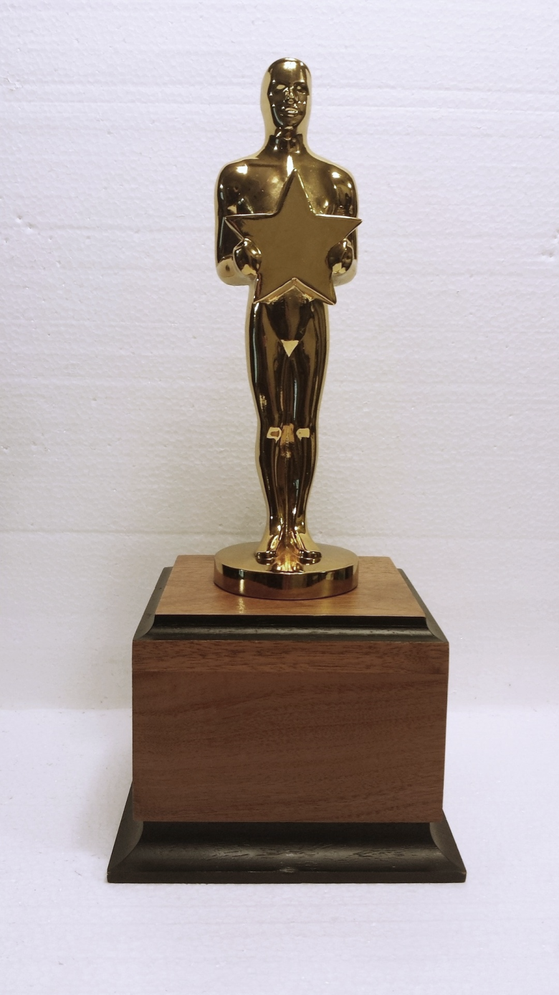
Discuss the questions and answer them.
What’s an Oscar?
Who awards the Oscars?
What are Oscars awarded for?
Can you name any films/actors/directors/scriptwriters that have won Oscars?
Have you ever watched an Oscar Awards ceremony?
What happens? What’s it like?
Would you like to attend it? Why/Why not?
How and why do some actors become famous?
Is it a hard job? Explain why you think so.
Would you like to be an actor/actress? Why/Why not?
Is it OK that some actors make so much money?
What do they spend their money on?
What do you think they should spend it on?
Do actors and directors give money to charity?
Is it hard for an actor to bring up a child?
A film award.
The American Film Academy.
Best film, best actor/actress, best film script/ best director, best supporting actor/actress, best music, best special effects, etc.

Slide 4
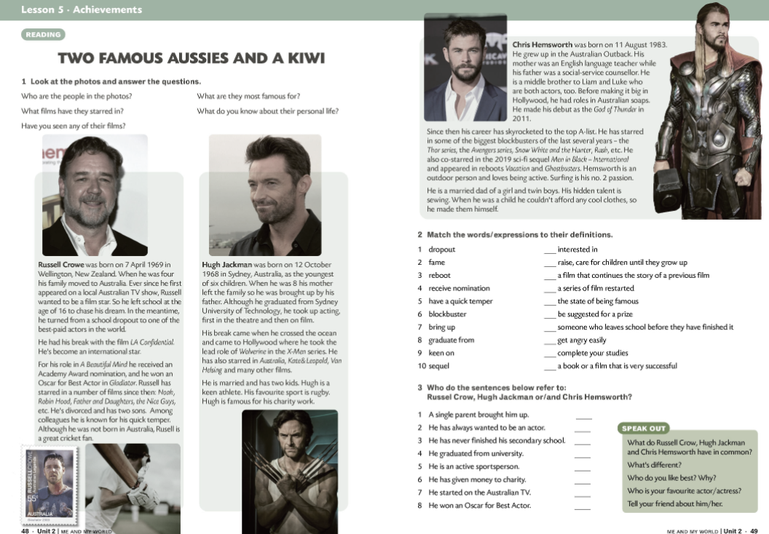
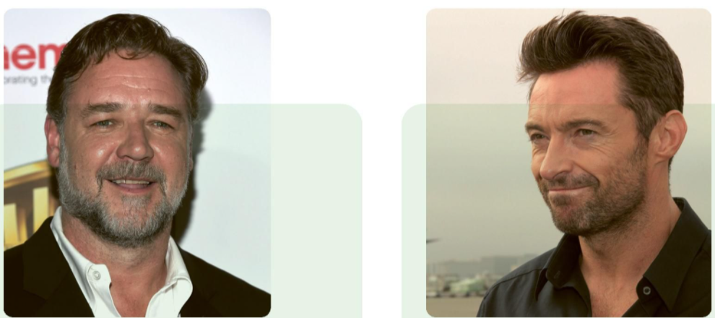
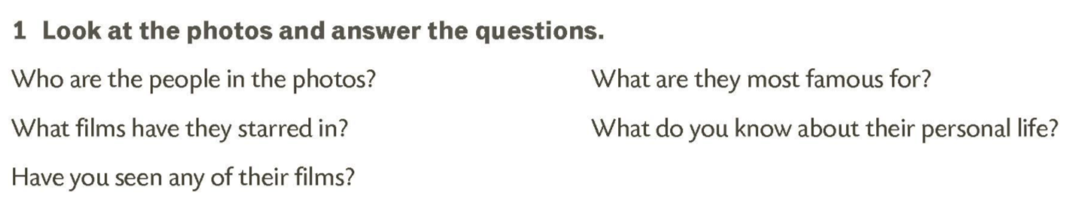
FAMILY
EARLY LIFE
CHARACTER
INTERESTS
ACTING CAREER

Slide 5
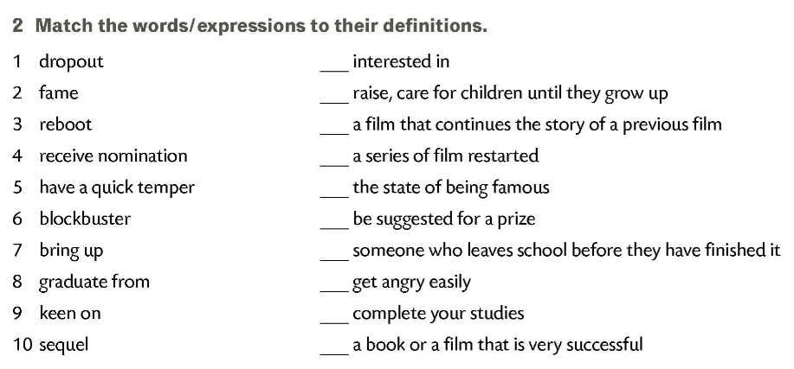
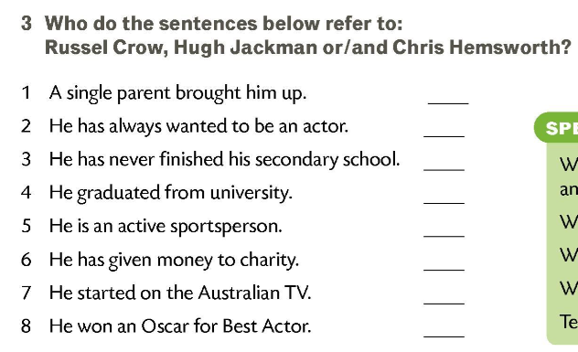
9
7
10
3
2
4
1
5
8
6
HJ
RC
RC
HJ
HJ, CH
HJ
RC, CH
RC

Slide 6
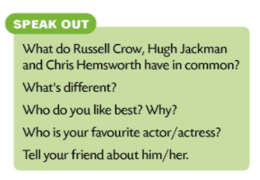

VOCABULARY CROSSWORD
PRESENT PERFECT SIMPLE
VOCABULARY
Next time you are going to write a biography of a famous actor or actress.
Collect as much information about him/her and bring all the information you have collected.

